Slide 1
Adham Ashraf Saeed
Assignment 3 (SQL)

Slide 2
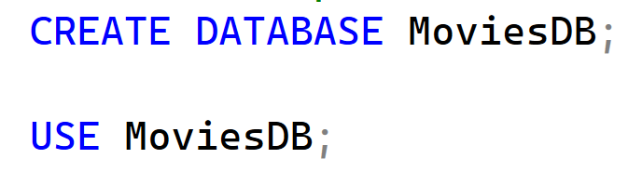
Load the provided dataset into your database
Open the provided link and build up your database.
Data Source

Slide 3


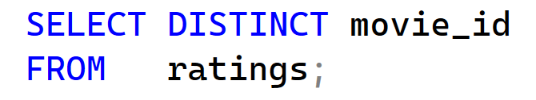
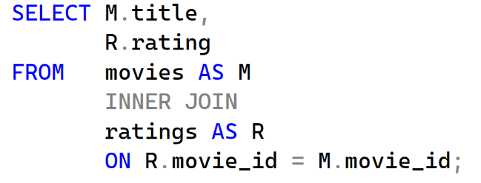
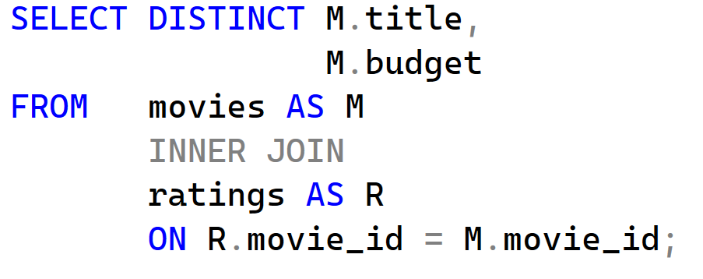
Questions
Display all movies
Display all movie ratings.
Display all movie IDs that appear in the ratings table.
Display movie titles along with their ratings.
Display movie titles and their budgets for movies that have ratings.

Slide 4
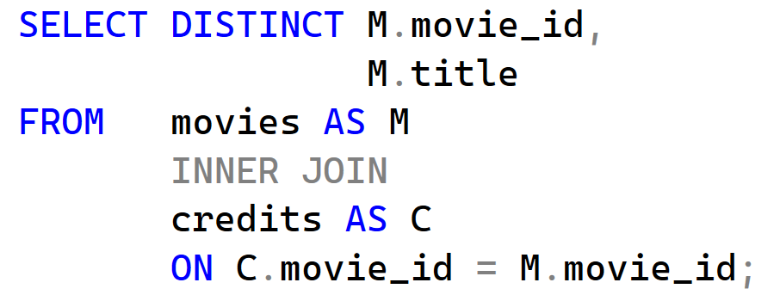
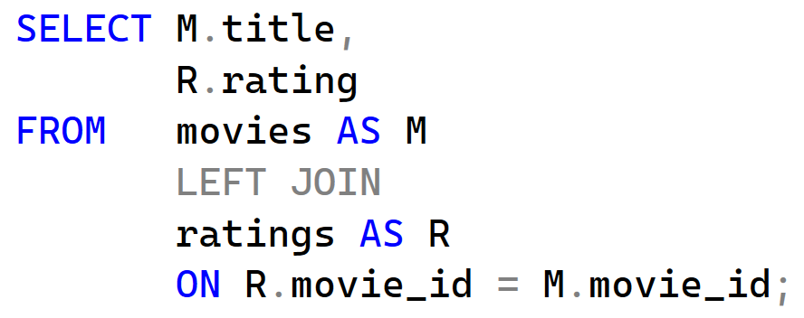
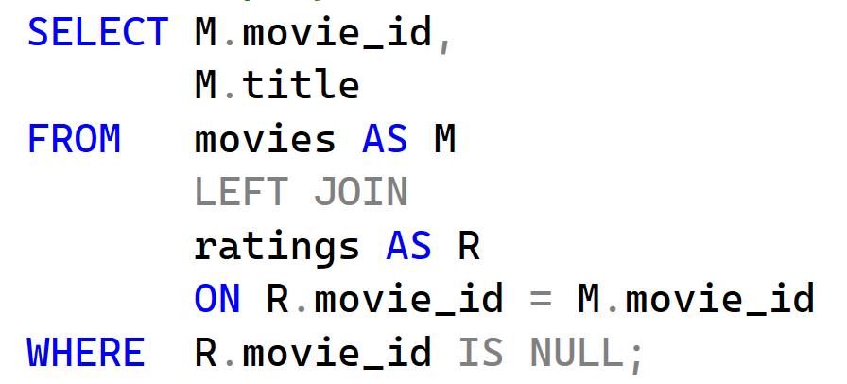
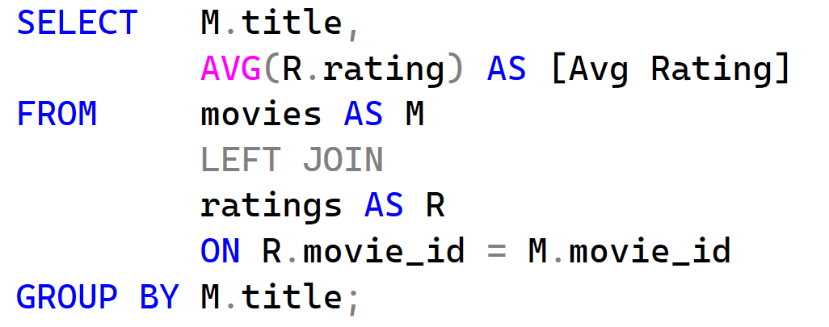
Questions
Display movies that appear in both Movies and Credits tables.
Display all movies and their ratings (include movies with no ratings).
Display movies that have no ratings.
Display movie title and average rating (include movies with no ratings).

Slide 5
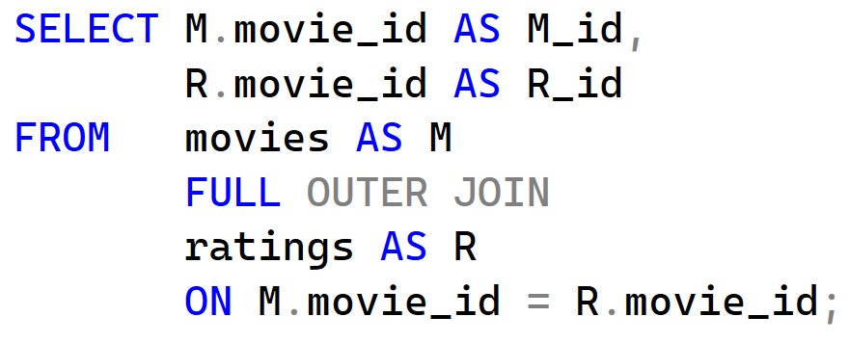
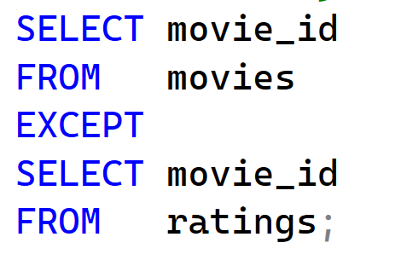
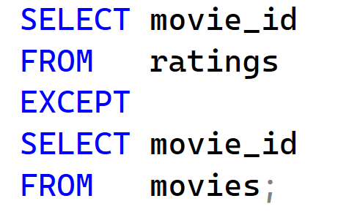
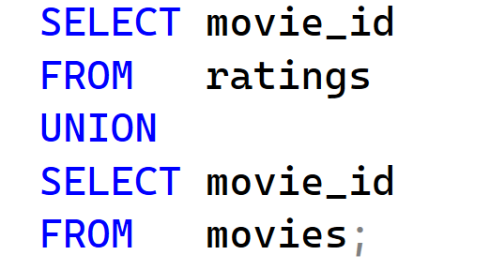
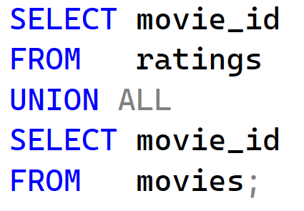
Questions
Display all movie IDs from Movies and Ratings, matched where possible.
Identify movies that exist in Movies but not in Ratings, and movies that exist in Ratings but not in Movies.
Display a list of all movie IDs from Movies and Ratings without duplicates.
Display a list of all movie IDs from Movies and Ratings including duplicates.

Slide 6
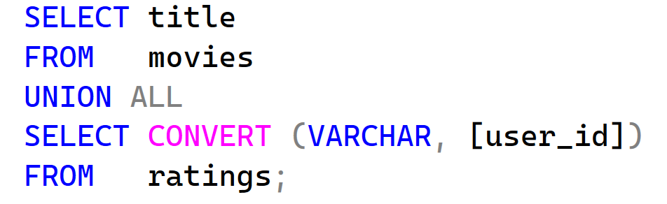
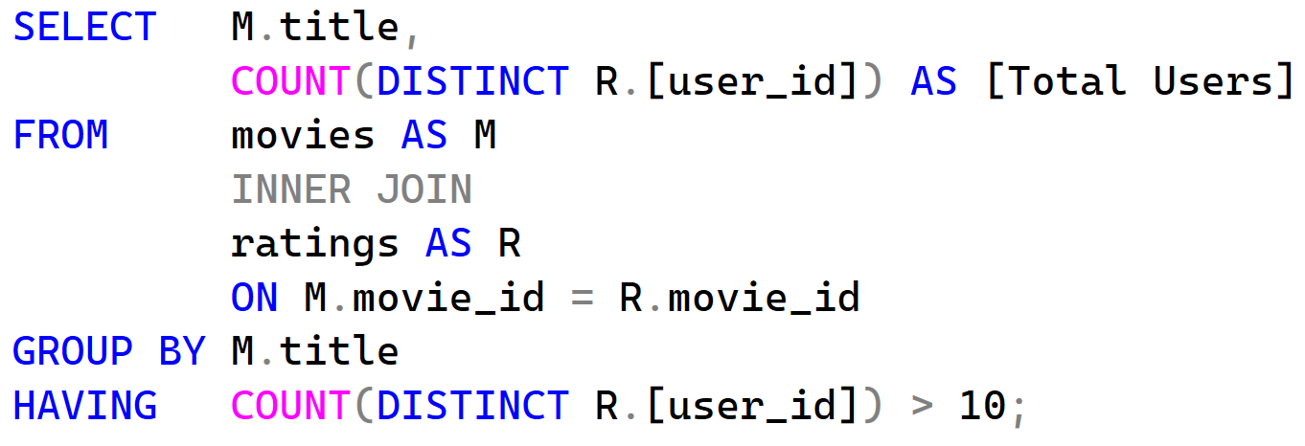
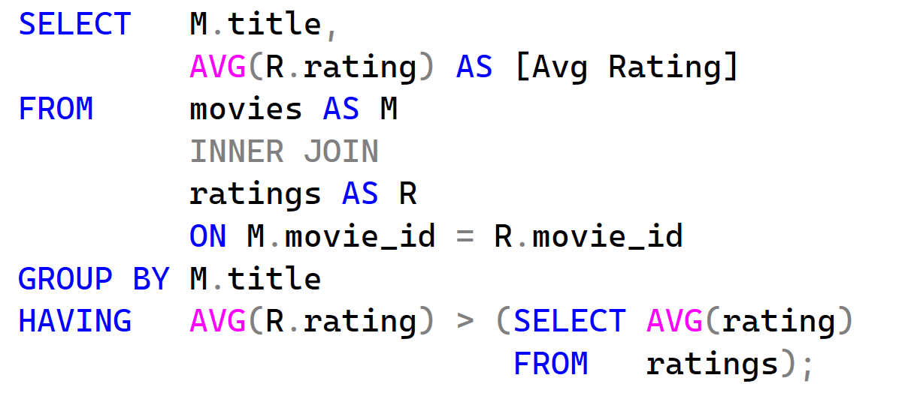
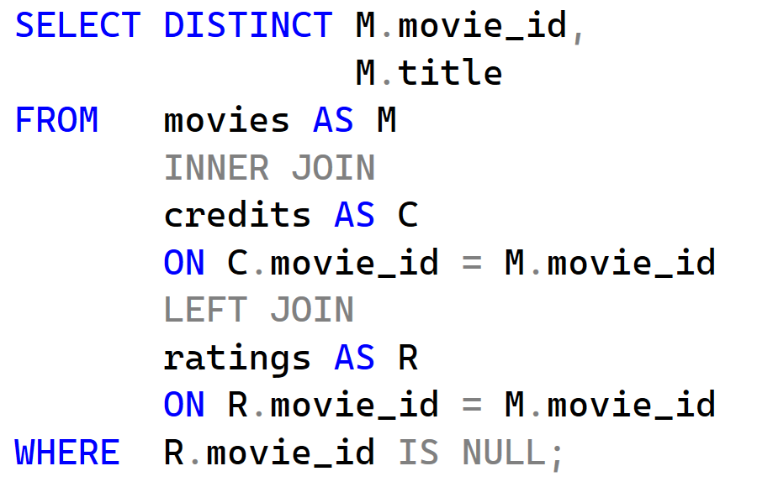
Questions
Display all movie titles and all user IDs in a single column.
Display movies that have ratings from more than 10 different users.
Display movies whose average rating is higher than the overall average rating.
Display movies that appear in Credits but have no ratings.

